Slide 1
Place where I draw documentation pictures
For Channel 2 version 1

Slide 2


Amps with effects loop
Instrument #1
Amp tone controls affect Instrument #1
Bass Amp
Speaker
Instrument
Input
Effects Send
Effects Return
Channel Two
Preamp
PassThru
Out
Instrument #2
Main
Channel Two tone controls affect Instrument #2
Picture credits: Wikipedia

Slide 3
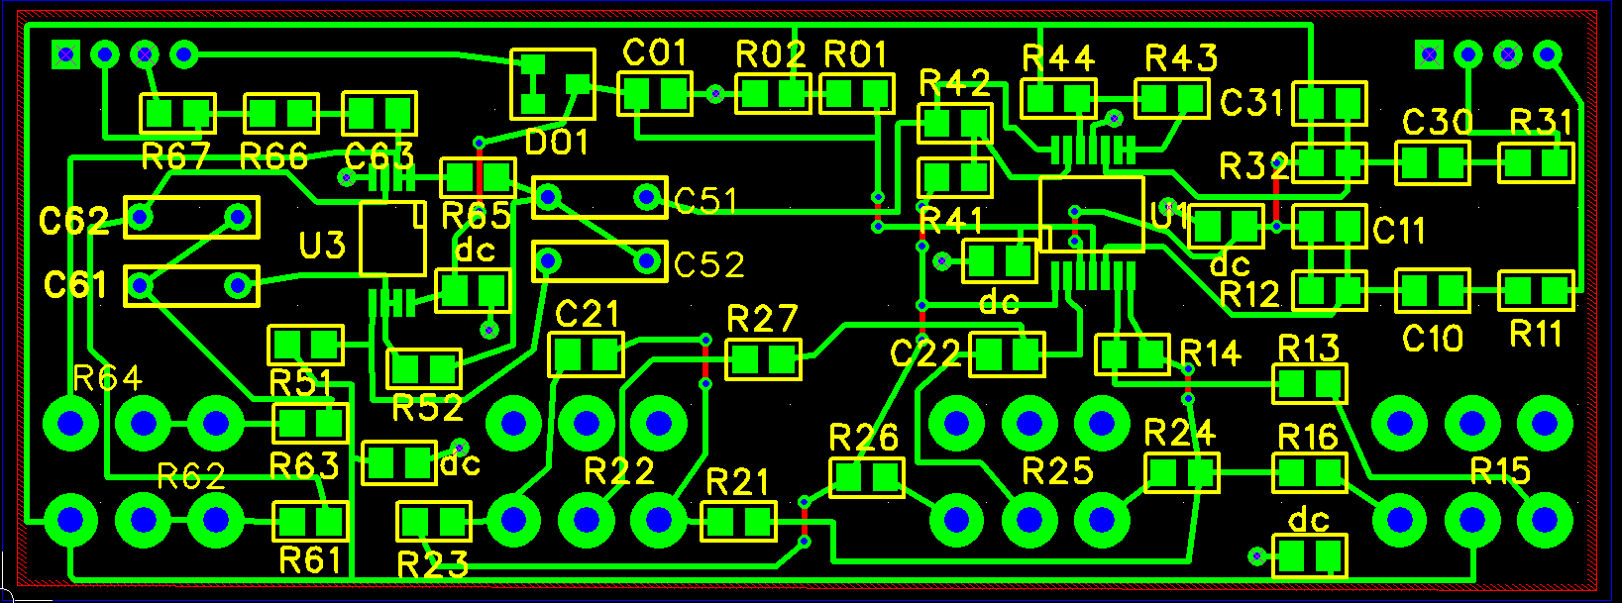
Test points
A6
Vs
Vh
A4
A2
A3
A5
A1
A1 – A6 are op amp outputs
Vs is power supply voltage
Vh is ½ the power supply voltage

Slide 4
Amps with “Aux” input
Instrument #1
Amp tone controls affect Instrument #1
Bass Amp
Speaker
Instrument
Input
Aux Input
Channel Two
Preamp
PassThru
Out
Instrument #2
Main
Channel Two tone controls affect Instrument #2
Picture credits: Wikipedia

Slide 5
Amps without additional jacks
Instrument #1
Amp tone controls affect both instruments
Channel Two
Preamp
Bass Amp
Speaker
PassThru
Out
Input
Main
First, set up amp tone controls to sound good with Instrument #1. Then adjust controls on Channel Two for best sound on Instrument #2
Instrument #2
Channel Two tone controls affect Instrument #2
Picture credits: Wikipedia

Slide 6
Gain
Control
Main
Input
Bass Treble
Variable
HPF
Mix
Output
10 Meg
Gain = 0 dB
Pass
Thru
10 Meg

Slide 7
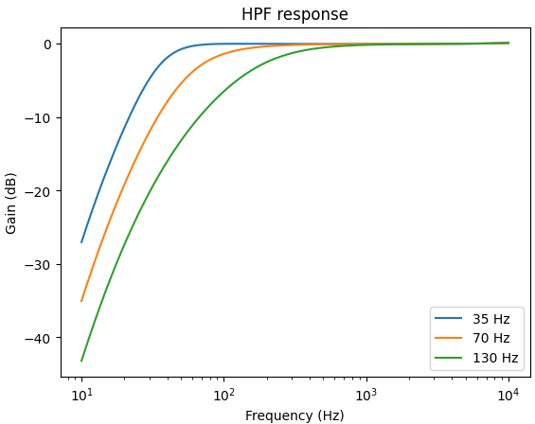
12 dB/oct
24 dB/oct
24 dB/oct

